Slide 1
3D Point Cloud Registration for Localization using a Deep Neural Network Auto-Encoder
Notes:
题目：基于深度神经网络自动编码器的三维点云配准定位技术
文章主要讲述了一种大范围点云与近距离经筛选的点云之间配准的算法，这是一种完全独立于两点坐标系中初始信息的定位方法。这种方法很好的解决了对于粗点云配准的问题，以往都是利用人工设计的关键点描述符进行配准，新方法利用超点代替关键点可以更好地利用几何数据追踪到精确的点云变换。

Slide 2
Contents
1. Introduction
2. The LORAX Registration Algorithm
3. Experiments and Results
4. Conclusion
Notes:
下面我将用四个方面介绍这篇文章的主要内容：综述、LORAX配准算法、实验方法及结果，最后简单说下结论部分。

Slide 3
1. Introduction---Overview
A point cloud is a set of unorganized three-dimensional points in a unified coordinate system, capturing 3D spatial information.
Point cloud registration is defined as finding the transformation between two separate point cloud coordinate systems.
Outdoor localization today relies heavily on GPS technology, accompanied by ground based augmentation systems to improve accuracy.
In this paper we focus on a localization technique that relies on registering a large-scale point cloud and a small-scale point cloud scanned within a scene at different times.
Notes:
先简单介绍下关于点云的一些重要概念。点云就是指一系列在同一坐标系中无序存在的三维点，最主要的作用就是描绘三维空间信息。点云配准意思就是寻找在两个分离的点云坐标系中的变化。目前户外的定位技术主要还是依赖于GPS定位，由路基增强系统辅助于精度的提高。这篇文章他们介绍了依赖于点云配准的定位技术，这项技术主要是通过在不同时段的同一场景中配准一个大规模点云和一个小规模点云来实现的。

Slide 4
1. Introduction---Related Work
Registration algorithms are divided into those dealing with coarse registration and those dealing with fine registration.
Coarse registration methods: FPFH, 3D-SIFT, NARF, and SHOT.
In the field of 2D computer vision, the development of hand-coded features come to an end due to deep learning.
SLAM was studied for the problem of fine registration between point clouds. The solutions revolve around the Iterative Closest Point (ICP) algorithm and its improvements.
Notes:
配准算法分为两种：一种为粗略配准，一种为精确配准。粗略配准是指不进行点云位置的预估只进行粗略对准，这意味着形成不严格的损耗函数；精确配准是指先预计输入的点云近似对齐，再利用点云之间的初始距离来微调点云坐标系之间的基准线。粗点云配准方法有很多，例如快速特征直方图算法就是利用描述符来计算大范围点云变换。其他的还有3D-SIFT, NARF和SHOT等。在二维计算机视觉领域，深度学习的出现限制了人工编码的发展。对于机载激光点云，可利用线性平面匹配来进行粗配准。SLAM方法可应用于点云的精确配准。该方法主要利用ICP及其衍生算法进行配准。

Slide 5
1. Introduction---Contribution
Using super-points (selected by a Random Sphere Cover Set) as the basic units for matching, instead of the commonly used key-points or local linear structures.
Encoding local 3D geometric structures using a deep neural network auto-encoder.
We designed our algorithm to be effective on large-scale scanned data and it is possible to be applied to real-time analysis.
Notes:
这篇文章介绍了两种应用于点云配准的方法：1）利用超点代替传统关键点和局部线性结构作为匹配的最基本单元；2）利用深度神经编码器对局部三维几何结构进行编码。结合两种方法可以解决多种数据类型，并且可以应用于实时数据分析。

Slide 6
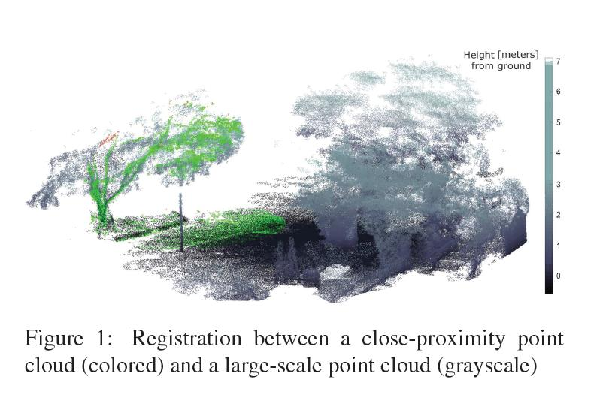
2. The LORAX Registration Algorithm
The global point cloud can contain as many as ~100 million 3D points, while the local point cloud is two-to-three orders of magnitude smaller.
Notes:
下面重点介绍LORAX这个点云配准算法。这种算法主要的配准对象是描绘大范围户外区域的整体点云以及在大型点云中捕获的局部点云系统。如图所示，绿色部分为局部点云系统，灰色部分是整体点云系统。大型点云可以包含一亿多个三维点，局部点云数量可以小至二到三个数量级。

Slide 7
2. The LORAX Registration Algorithm
a. Division of the point clouds to super-points using the new Random Sphere Cover Set algorithm.
b. Selection of a normalized local coordinate system for each super-point.
c. Projection of super-point data onto 2D depth maps.
d. Saliency detection and filtration of super-points.
e. Dimension reduction using a Deep Neural Network Auto-Encoder.
f. Finding candidate matches between correlating descriptors.
g. Coarse registration using a localized search.
h. Iterative Closest Point fine-tuning.
Notes:
以下列出的是LORAX配准算法的步骤：1.利用新式随机球覆盖集算法从点云中划分出超点；2.为每一个超点选择一个归一化局部坐标系；3.将超点数据投影到二维图上；4.对超点进行显著性检测和筛选；5.通过深度神经网络自动编码器进行降维；6.对相关的描述符进行匹配；7.利用局部搜索进行粗略配准；8.迭代最近点法进行精确调整

Slide 8
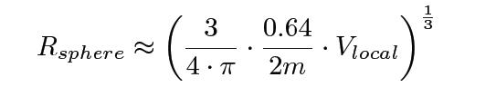
a. Random Sphere Cover Set (RSCS)
First, the set of super-points (SP) that will be used as the basic units for the matching process is defined.
The procedure is as followed: (1) randomly select a point P that does not yet belong to any SP; (2) define a new SP as the set of points located inside the sphere of a fixed radius R_{sphere} with P as its center.
Let V_{local} be the volume of a sphere encompassing the local point cloud and let m be the number of matches used in the final stage of the algorithm.
Notes:
下面逐条介绍具体算法步骤，第一步利用随机球覆盖集算法划分出超点集。把超点作为最基础的匹配单元，每个超点描绘的都是一个局部平面的点的子集。具体步骤如下：1）随机选择不属于任何一个超点的点P；2）以P为中心，R_{sphere}为半径的球形内的点都定义为一个新的超点集。在此我们将V_{local}定义为包含局部点云的球形体积，m为算法最终阶段的匹配数量。R_{sphere}的计算公式如下，大致64%d的超点集球体没有交叉或者覆盖，这样计算是保证m为最小值的情况下，可以随机地选择V_{local}体积内的2m球形。对大型点云集合执行一次RSCS算法，局部点云集合应用多次算法。在下一步算法中，应用多次RSCS算法找出的局部点云中的超点将与代表局部点云的单个集合相结合。

Slide 9
b. Selection of a Normalized Local Coordinate System for each Super-point
The origin is set to be the centroid of the SP, then the coordinate system of the SP is set using Singular Value Decomposition (SVD) on the estimated covariance matrix of the points within the SP.
The eigenvalues of surfaces hold two large eigenvectors of similar size and one smaller eigenvector. The points are mostly scattered in two dimensions while the third dimension has significantly lower variance.
The z-axis is set to be the third eigenvector. The mean height of discrete radial slices of the SP are calculated and inserted into a polar histogram, then the x-axis is set to the direction corresponding to the largest bin.
Notes:
为每一个超点选择一个归一化局部坐标系。以超点集的质心为原点，对超点集范围内的点的预估协方差矩阵使用奇异值分解法建立起超点集的坐标系。表面特征值包含两个相似大小的大的和一个稍小一点的特征向量，点主要聚集在两个方向上，z轴是第三个特征向量。计算超点集的离散镜像切片的平均高度并插入极坐标直方图中，x轴就是最大束的方向。

Slide 10
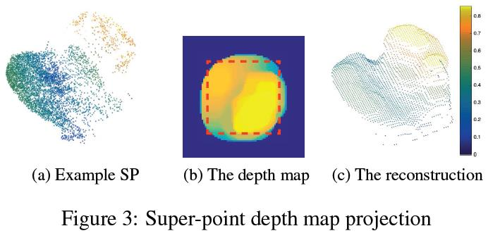
c. Depth Map Projection
The continuous point location data is converted into a discrete image format (of size [d_{im1}, d_{im1}]).
The z-axis height of each point is projected onto the depth map for each corresponding pixel.
The SP is scaled to the dimensions of the image d_{im1} (we used d_{im1} = 64).
The image is cropped to [d_{im2} , d_{im2} ] (we used d_{im2} = 32), to remove the circular edges of the SP in the depth map.
To reduce the effects of noise and varying densities, a max filter and then a mean filter are applied to the image.
Notes:
建立局部坐标系后就可以对超点集进行配对，但是这一结果会受到点的密度以及随机噪点的影响。这时就要对其进行降维。将连续点的位置数据转换成以[d_{im1}, d_{im1}]为大小的离散图像形式，每个点的Z轴高度投射到每一对应像素的深度图上，超点集缩放至d_{im1}的图像尺寸，去掉超点集在深度图中的弧形边缘将图像缩放至[d_{im2} , d_{im2} ]大小。如图a和b所示，将超点投射成深度图。下一步对图像应用最大值滤波和均值滤波，减少噪音和不同密度的影响。如图c所示，重建的影像很好的保留了原有超点集的几何特征和品质，并且还对未知稀疏区域也进行了完全覆盖。

Slide 11
d. Saliency Detection and Filtration
Irrelevant SPs are filtered out by three criteria: density, geometric properties, and saliency levels.
Density Test: SPs containing fewer than N_{d} points are filtered out, and SPs with relatively few points in comparison to their K nearest neighbor SP (Euclidean distance is measured between SP centroids) are also filtered out.
Geometric Quality Test: The height of each SP within its individual local coordinate system is measured, and low height SPs, which signal flat surfaces, are filtered out.
Saliency Test: SP depth maps from the global point cloud are reshaped into a column “depth vector” of length d²_{im2}. A Principal Component Analysis (PCA) is performed for the set of depth vectors. The SPs using only the first three eigenvectors are filtered out.
Notes:
第四步是进行显著性检测和筛选。在这一步骤中，不相关的超点将通过密度、几何特性以及显著性水平这三个标准过滤掉。（1）检测密度不仅要测出绝对值并且要进行对比，少于N_{d}点的超点要被过滤掉，若相比于它们K最近的超点集来说，拥有相对较少点的超点集将被过滤掉。（2）检测几何特性，反应平坦表面的超点将被过滤掉，即高度较低的超点。（3）显著性检测，将超点深度图重塑成一列长度为d²_{im2}的“深度矢量”。对深度矢量集合进行主元件分析（PCA），只应用原来三个矢量的超点集将被过滤掉，这减少了点云中不同位置的近似超点之间配对的可能性。

Slide 12
e. Auto-Encoder Dimension Reduction
The dimension reduction is needed in the comparison between SP geometries from within global and local point clouds. Two methods are introduced here.
PCA(Linear Dimension Reduction): A base of k eigenvectors are calculated from the depth vectors of the global point cloud SP. The k eigenvalues corresponding to the eigenvectors define the super-position required to recreate each SP. This compact representation feature holding geometric information of the SP is denoted as the Principal Component Analysis Super-point Feature (PCAF).
DAE(Deep Auto-Encoder Dimension Reduction): DAE neural network architectures consists two stages: encoder and decoder. The encoder stage starts with the input layer and then is connected to hidden layers, and the decoder stage starts with the compact representation of the data.
Notes:
对超点这种高纬度的物体进行几何结构对比时容易引起噪点和偏差，这时就需要对其进行降维，在此介绍两种不同的降维方法。（1）线性降维，基于PCA的降维方法。这一方法降低的是投射到低维线性超平面上的数据的维度。从整体点云超点集的深度矢量计算出k特征向量的基数，重塑每一超点集的超级位置为特征向量相对应的k特征值。我们将这种保留超点集的几何信息的紧凑表示特征表述为主元件分析超点特征。（2）深度自动编码器降维（DAE），应用DAE神经网络可以获得最先进的图像压缩，在此我们利用这一技术获得在深度图中的2.5维超点几何结构的紧凑表示。编码器和解码器是DAE神经网络的两个最主要构件，编码器由输入层开始并连接到隐藏层，在此逐渐降低维度直至达到所需的紧凑维度；解码器开始于数据的紧凑表示，隐藏层维度逐渐提高，直至输出层与输入层相同。

Slide 13
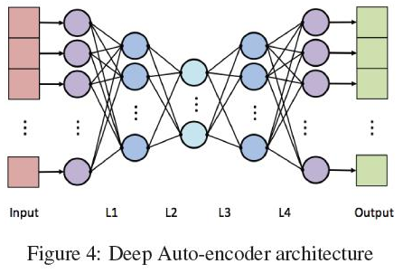
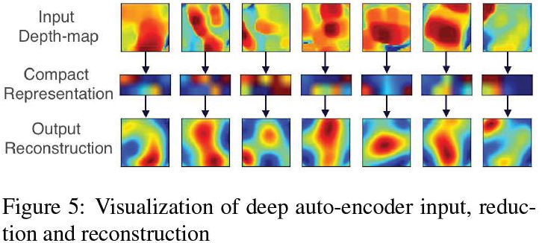
e. Auto-Encoder Dimension Reduction
4 fully connected hidden layers are used in the network. the 4th and 1st hidden layers as well as the 3rd and 2nd layers mirror each other with identical weights. The dimensions are as followed: 1032(Input), [1032,128](L1), [128,10](L2), [10,128](L3), [128,1032](L4), 1032(output).
Examples of depth maps input into the DAE and reduced to a 10-dimensional SAF and then reconstructed to the original dimensions through the decoder.
Blue corresponds to zero height and dark red corresponds to maximal height.
Notes:
DAE网络由四个完全相连的隐藏层构成，在每一隐藏层之间应用S形非线性激活函数，对输入层应用Dropout（DO）算法。第四和第一，以及第三和第二个隐藏层各自形成镜像对称并且高度相同。该结构应用的维度如下：1032(Input), [1032,128](L1), [128,10](L2), [10,128](L3), [128,1032](L4), 1032(output)。先利用包含十万个超点数据的深度图对这一DAE网络结构进行初始训练。图5就是一个将深度图应用到DAE网络的例子，先是输入深度图，接着简化为10维的紧凑表示，再通过解码器重建成原始维度，在这里颜色表示深度图中的高度，蓝色代表高度0，红色代表最高的高度，虽然重建的图像与输入图像不完全对等，但已经反应出了超点集的大致几何特性。

Slide 14
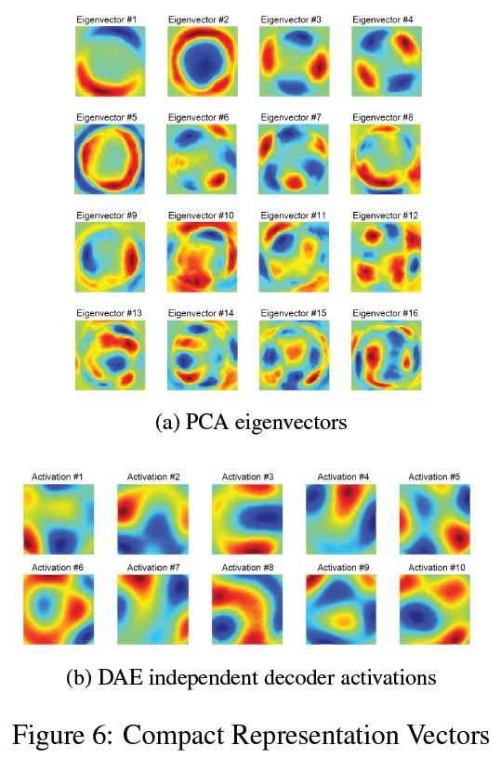
e. Auto-Encoder Dimension Reduction
The pic shows the comparison of the eigenvectors between PCA and DAE methods.
The growing complexity of each PCA eigenvector, is in contrast to the unstructured DAE activation images.
The PCA method can be approximated as a single hidden layer neural network with only linear functions.
Due to multi-layered super-position of the values in the DAE, complex geometry is represented using relatively simple “building blocks”.
Notes:
我们还将应用PCA和DAE两种方法的结果进行了对比，将PCA方法的特征向量和DAE方法的独立解码器激活因子进行比对，图a显示出PCA方法的特征向量是按特征值排序增长的，这与图b中DAE激活图像正好相反。PCA方法可以看做是一个只具有线性作用的单一隐藏层神经网络，应用这一方法表示复杂的几何结构时就需要多种特征向量的介入。与此不同的是，DAE方法中特征值已经应用了多层的超级位置结构，表达复杂几何特性时反倒简化了基础结构。

Slide 15
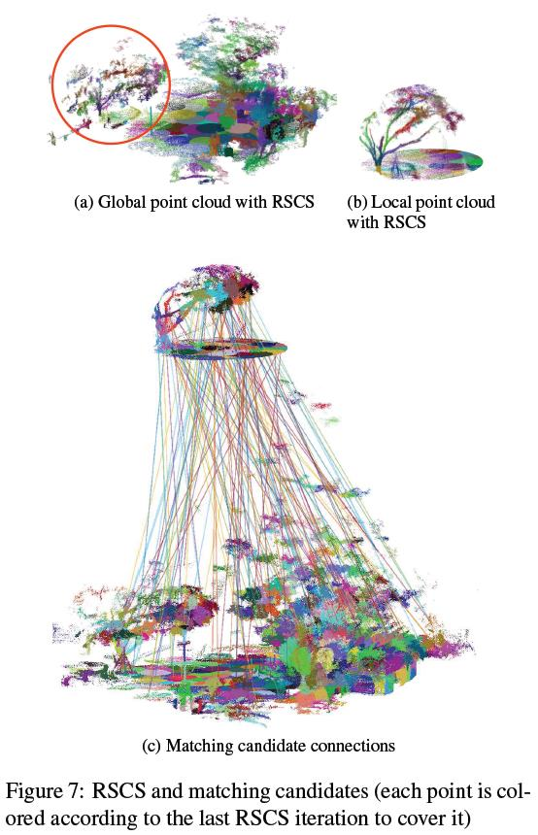
f. Selecting Candidates for Matching
By measuring the Euclidian distance between SAF features, each SP in the local point cloud is paired with its K-nearest-neighbors from the global point cloud (we set K to 3).
When the distance associated with the i+1 nearest neighbor is significantly larger than that associated with the i nearest neighbor, we filter out candidates i+1 to K.
About 550 candidates are selected by considering a problem set with a global point cloud of 10 million points, and a local point cloud of 500 thousand points.
Notes:
将每个超点集通过SAF向量描绘出来之后，下一步就是选取相似的超点集组队进行配对，根据测量SAF特征间的欧几里得距离，局部点云系统中的每个超点集与其整体点云系统中的K值最近的超点集进行配对，在这里K等于3。当与i+1个最近的超点集的距离明显大于i个最近的超点集时，筛选掉i+1个到K。为方便理解，我们假设有一个1千万点的整体点云系统和一个50万点的局部点云系统，那么大概就有200个超点集，即550个候选组被筛选出来。

Slide 16
g. Coarse Registration by Localized Search
RANSAC procedure is used, iteratively selecting 6 candidate-pairs, computing a transformation, and checking the consensus by measuring the average (physical) distance between transformed points in the local point cloud and their nearest neighbors in the global point cloud.
Instead of selecting only the best scoring transformation as the result of the coarse registration step, we record the 5 best transformations (T1, . . . ,T5) in which the local point clouds are non-overlapping.
Then the one that yielded the best scoring fine registration is finally selected after the fine-tuning step is applied.
Notes:
通过局部搜索进行粗略配准。在此我们使用RANSAC方法进行粗配准，通过测量局部点云系统中转化点与其在整体点云中的最近的超点集的物理平均距离，迭代地选择6个候选对、计算变化并进行一致性检查。我们随机检测了1万个对象。在局部点云系统不重叠的区域，我们记录了5个最好的点云变化（T1….T5）而不是只选择粗配准最好结果的点云变换。下一步经过精确配准后，表现最佳的点云将作为最终结果保留下来。

Slide 17
h. Iterative Closest Point (ICP) Fine-tuning
Simple Iterative Closest Point (ICP) fine tuning is performed, initialized by each of T1, ...,T5 transformations. The registration with the lowest ICP loss is chosen, defining the LORAX output transformation.
The best fine registration is shown empirically to correspond to the best coarse registration in about 75% of the cases, the second-best in about 18% of the cases, and the third-best in about 4%.
Our current implementation was not optimized for real-time performance. However, this algorithm does have the potential to be incorporated in field equipment and perform real-time localization. The code for the RSCS method and SAF descriptor are available at: https://github.com/gilbaz/LORAX.
Notes:
利用迭代最近点（ICP）法进行微调，由上一步选取的5个点云变化进行初始化，选取ICP损失最低的配准定义为LORAX法的输出点云变化。应用这一步骤进行微调的原因是，粗略配准的结果并不都是正确配准结果，这是由优化过程中一些极小值存在引起的。精确配准的最佳结果大致是最佳粗略配准的75%，依次降低。
我们目前所做的实验没有对其实时性进行优化，但是该算法是有可能被应用于现场设备并进行实时定位的。LORAX方法捕获的点云影像将比雷达和立体重画技术更快速，神经系统网络训练过程和整体点云计算至降维这一步都可以是线下完成，点云的紧凑描述符储存到线上设备中，从整体视野中一个未知位置实时捕获一个局部点云后，此后的步骤都可以次在线上进行操作。

Slide 18
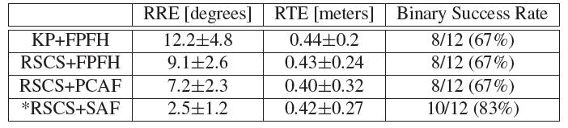
3. Experiments and Results
Each stage of the registration was extensively tested using the “Challenging Datasets for Point Cloud Registration Algorithms”, matching a close-proximity point cloud to a global large-scale point cloud of the same scene captured in two different seasons.
Compare the registration performance with RSCS super-points vs. with key-points, and with FPFH descriptors vs. PCAF and vs. SAF.
For each registration result we measure the relative translational error (RTE) and the relative rotation error (RRE). When the RTE is below a predefined threshold (we used 1 meter), the registration result is defined as a binary success.
Notes:
在实验中，对比FPFH运用连续性关键点，结果会显示RSCS方法运用超点的优势，除此之外，SAF的描述质量也将与FPFH描述符进行对比。配准的每一步都要进行“用于点云配准算法的挑战性数据集”检测，配对同一场景中不同时期捕获的近距离和整体大型点云。此外，通过控制变量检测不同干扰因素对配准的影响。
1.挑战性数据集配准：对比不同配准表现。“RSCS+FPFH“方法计算的是与FPFH描述符相对应的RSCS超点集的中心点。每个输出结果都是由12个局部点云的平均结果，9个来自”Gazebo”数据集，3个来自“Wood”数据集。对每个配准结果我们测量了相对平移误差（RTE）和相对转动误差（RRE）。当RTE低于临界值（设为1米）时，配准结果是双重成功的。如表所示，输出结果由成功测试的双重成功率、平均RTE和RRE数值组成。由结果可知，利用机器学习的特征性明显优于人工设计的特性。

Slide 19
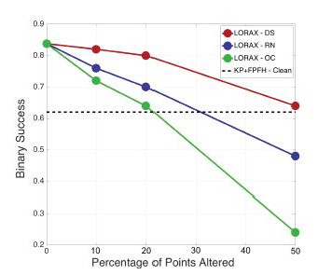
3. Experiments and Results
In order to be able to control different parameters of noise, density and occlusions, we performed semi-synthetic experiments in which small point clouds with radii of 15-50 meters were cropped from the large original point clouds.
50 randomly cropped point clouds from 3 full scenes were tested to analyze the effects of down sampling (density change) (DS), random relocation noise (RN), and occlusions (OC) on each.
Overall we see that LORAX is not sensitive to substantial levels of random noise, density change and occlusions, and that its robustness deteriorates only at extreme levels. The KP+FPFH algorithm (dashed line) returned a low binary success rate when tested on clean local point clouds due to the lack of “key-point” inducing scene features, in many sections of the global point cloud.
Notes:
2. 控制变量：我们利用几个市内的室外场景的点云系统来进一步检测LORAX算法的质量和局限性。我们对从原始大型点云系中分离出来的半径为15-50米的小型点云系进行半合成实验来控制干扰、密度和遮挡物的不同参数。从三个完整场景中随机裁剪出50个点云系进行检测，分析采样的密度变化（DS）、随机重定位干扰（RN）和遮挡物（OC）的影响。如图所示，每个点代表的是50个配准测试的平均双重成功率，这样对干扰标准进行了定义。LORAX对随机干扰、密度变化和遮挡物反应不敏感。KP+FPFH算法显示了低双重成功率，这些结果都表明了LORA算法的优势性。

Slide 20
3. Conclusions
LORAX deals with a multiple magnitude difference in the number of points between the two registered point clouds and with a large total number of points involved to achieve the outdoor localization.
We combine two original approaches to work with any data regardless of the type of sensor or scene. It could serve real-time application.
Future works: 1) adapt this approach for similar sized point clouds with small scene overlaps; 2) design a multi-scale super-point version of this algorithm; 3) use a convolutional auto-encoder with an input of height and color information.
Notes:
下面对本片文章进行总结：LORAX算法处理的是两种配准的点云系之间的点数上的多重量级不同点和大量的点云系统来实现户外定位的。无论传感器或场景的类型，我们都可以对数据进行处理，方法是结合两种原始方法来实现的。本方法可以应用于实时定位。对于今后的工作，我们提出以下设想：1.把此方法应用于小型重叠场景中的相似大小的点云系；2.为该算法设计一个多尺度的超点版本；3.使用带有输入高度和颜色信息的卷积自动编码器。

Slide 21
Thanks for your attention
Calvin Wong
20180315
Notes:
谢谢大家。

